Slide 1
Introduction to Discrete Event Simulation Session 2
Arnold Buss
MOVES Institute
Naval Postgraduate School
Monterey, CA 93943

Slide 2
Session 2 Overview
Multiple Server Queue Example
Running a Simulation By Hand

Slide 3
Example: Multiple Server Queue
“Customers” arrive to a facility one at a time
There are a certain number of identical ”servers”
If all servers are busy, arriving customers wait in a queue
When a server completes service, they start on the next available customer (if any)

Slide 4
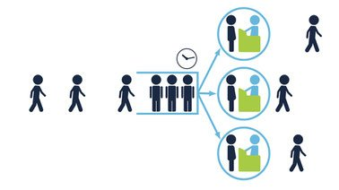
Multiple Server Queue (k=3)

Slide 5
Multiple Server Queue Model
Parameters:
{t_{A}} = Interarrival times
{t_{S}} = Service times
k = Number of servers
State Variables
Q = Number in queue (0)
S = Number of available servers (k)
L = Number in system (0)
Note: L = Q + k - S

Slide 6
Multiple Server Queue Events
Run
Set Q = 0, S = k
Schedule first Arrival with delay of t_{A}
Arrival
Set Q = Q + 1
If Server available (S > 0), schedule StartService with delay of 0.0
Schedule Arrival after delay of t_{A}

Slide 7
Multiple Server Queue Events (cont)
StartService
Set Q = Q -1, S = S -1
Schedule EndService after delay of t_{S}
End Service
Set S = S + 1
If customers in queue (Q > 0), schedule StartService with delay of 0.0

Slide 8
Execute Multiple Server Queue “By Hand”
Parameters
k = 1
{t_{A}} = {2.1, 1.4, 3.5, …}
{t_{S}} = {2.2, 1.3, …}
Stopping rule
Simulate for 2 customers completing service
i.e. Two End Service events

Slide 9
Start of Simulation
Always begin with states “undefined” and Run event on Event List t time 0.0

Slide 10
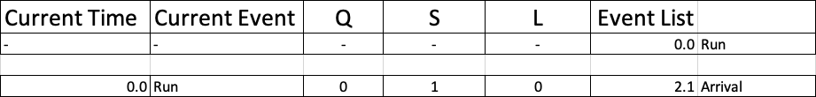
Execute Run Event
Advance time to next scheduled event (0.0)
Perform state transitions (Q = 0, S = 1, L = k – S + Q = 0)
Schedule any events: Arrival with delay of 2.1 scheduled at 0.0 + 2.1 = 2.1
This is now the status of the simulation

Slide 11
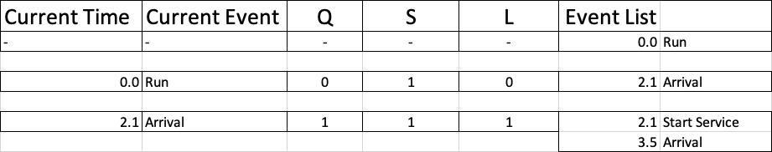
Execute First Arrival Event
Advance time to next scheduled event (2.1)
Perform state transitions (Q = 1, S = 1, L = k – S + Q = 1)
Schedule any events: Arrival with delay of 1.4 scheduled at 2.1 + 1.4 = 3.5; Start Service with delay of 0.0, scheduled at 2.1 + 0.0 = 2.1
This is now the status of the simulation

Slide 12
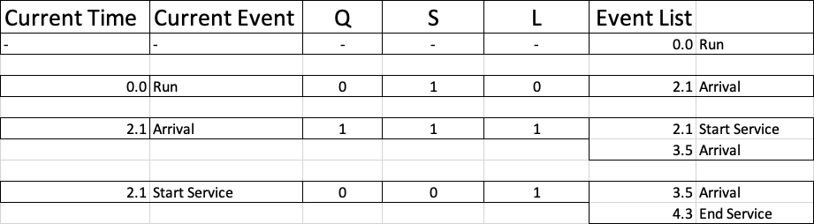
First Start Service Event
{t_{S}} = {2.2, 1.3}
“Next” t_{S} is 2.2
End Service scheduled at 2.1 + 2.2 = 4.3

Slide 13
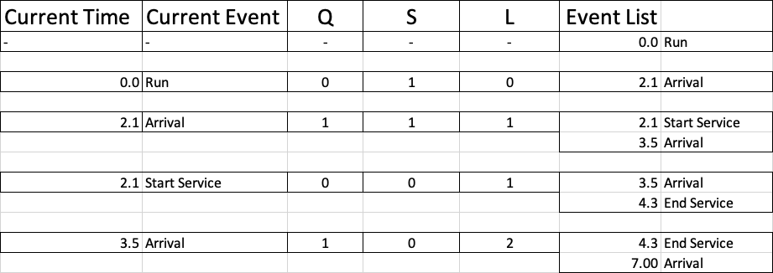
Second Arrival Event
Since S = 0, Start Service is not scheduled
Next Arrival event at 3.5 + 3.5 = 7.0

Slide 14
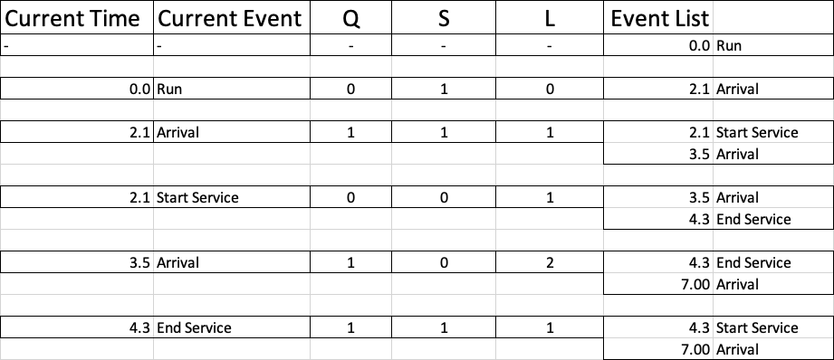
End Service Event
Since Q > 0, schedule Start Service with delay of 0.0

Slide 15
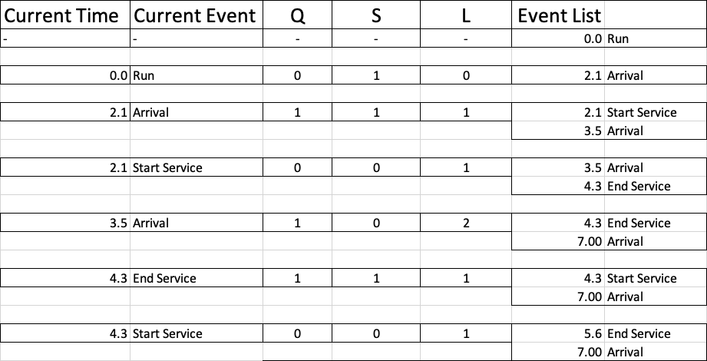
Second Start Service Event

Slide 16
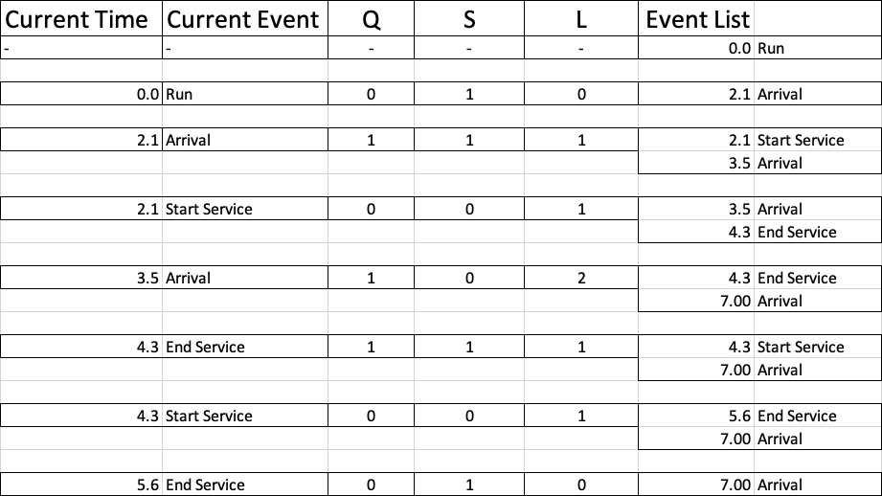
End of Simulation

